Slide 1
AWS & IOT ARCHITECTURE
The SIFT: Scalable IoT For Tenants
Architecting isolated smart home environments for thousands of users on AWS.

Slide 2

1. THE PROJECT TOPIC
Overcoming the Single-User Limit
router
Standard Home Assistant
cloud_queue
Cloud-Native Approach
LEGACY MONOLITHIC ARCHITECTURE
NEXT-GEN MULTI-TENANT SOLUTION
close
Strictly local deployment.
check
Strict container isolation.
arrow_forward
close
Cannot scale to multiple accounts.
check
Centralized device identity.
close
Severe data privacy risks.
check
Automated Kubernetes provisioning.

Slide 3
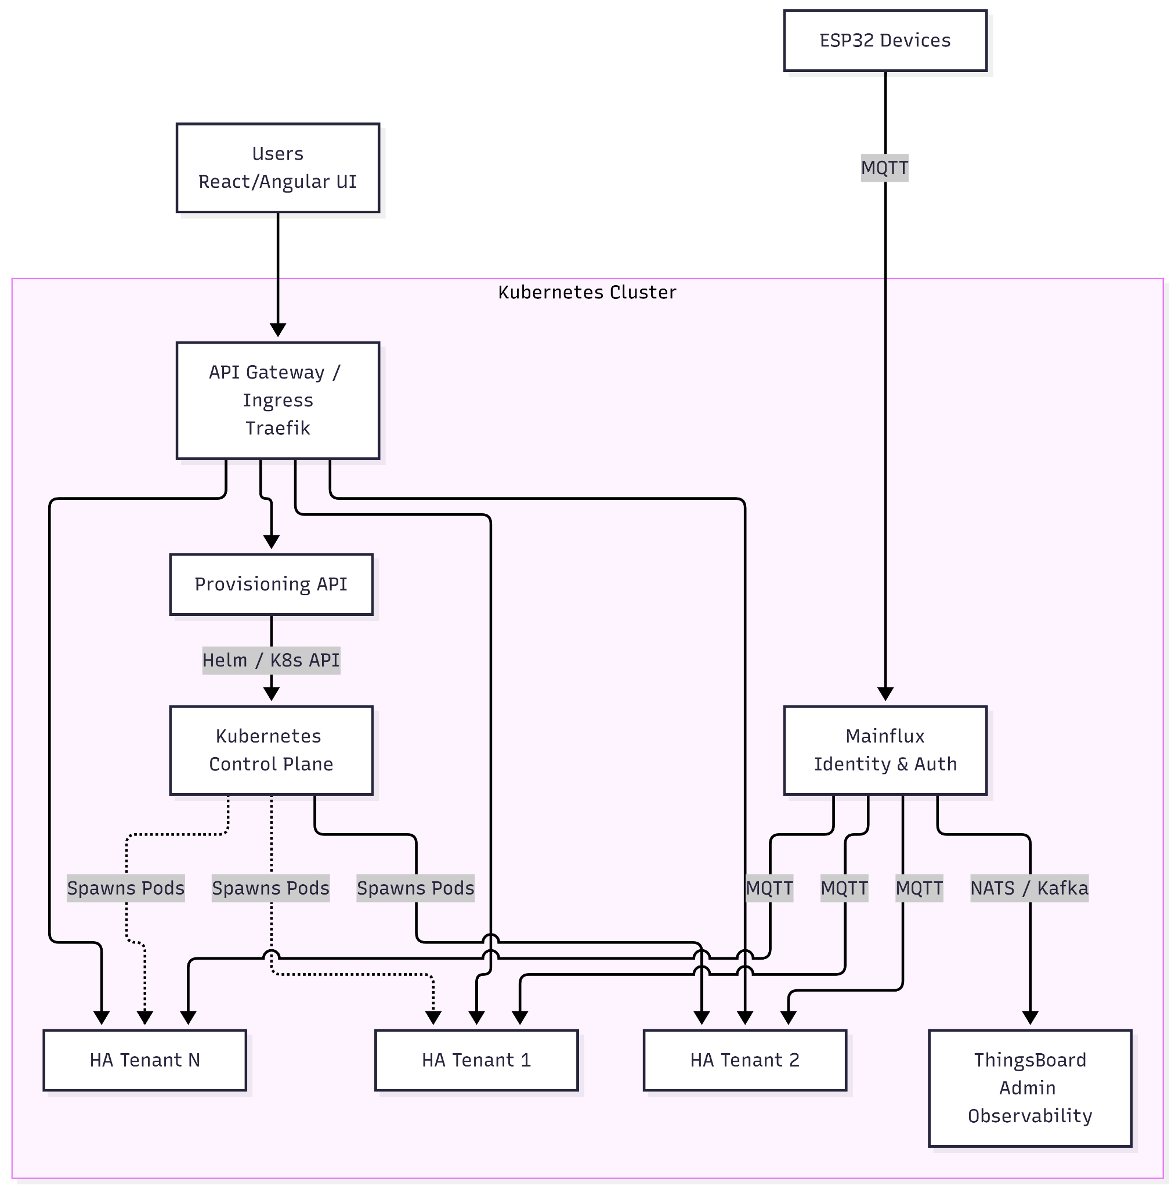
SYSTEM DESIGN
Architecture & Routing
Ingress Layer
Traefik routes inbound HTTP/MQTT traffic securely.
alt_route
Provisioning API
Commands K8s to spawn new tenant pods.
memory
Telemetry Pipeline
Hardware publishes directly to Mainflux.
hub

Slide 4
2. SERVICES INTENDED TO USE
Core Tech Stack
fingerprint
Mainflux
Identity & MQTT Broker
monitoring
ThingsBoard
Platform Observability
WHY IT'S USED
Absolute source of truth for platform credentials.
WHY IT'S USED
Tracks system-wide telemetry and alarms.
dns
Kubernetes (K3s)
Cloud Orchestrator
smart_toy
Home Assistant
Automation Engine
WHY IT'S USED
Automates pod creation for new users.
WHY IT'S USED
Mature, isolated UI for every tenant.

Slide 5
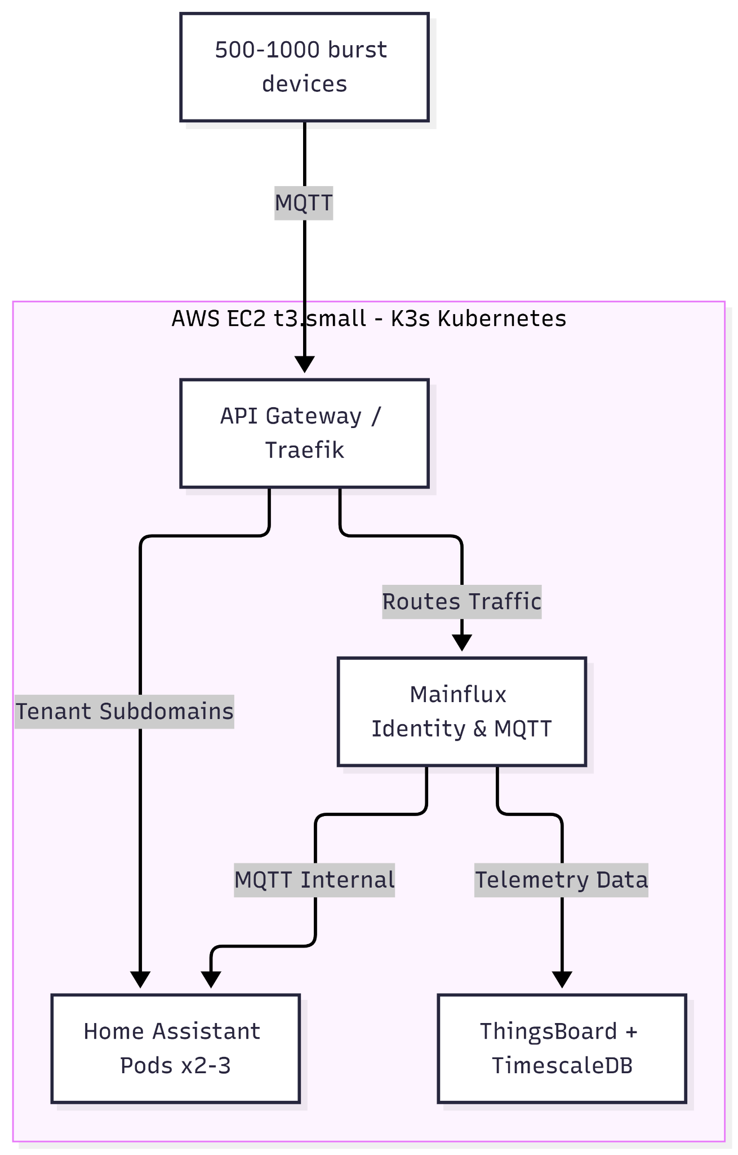
PROOF OF CONCEPT
Demo Deployment
Hardware Limits
Running entirely on one AWS EC2 t3.small.
memory
Fleet Simulation
Testing load with 1000 concurrent devices.
speed
Metrics Tracked
Throughput, CPU load, and provisioning speed.
insights

Slide 6
3. COST ESTIMATE
Production Scale Breakdown
SERVICE
AWS COMPONENT
MONTHLY COST
Orchestration
EKS cluster (1 control plane + 2x t3.medium nodes)
~$140
Mainflux & DB
EC2 t3.medium + RDS PostgreSQL (db.t3.micro)
~$60
ThingsBoard & DB
EC2 t3.medium + RDS PostgreSQL (db.t3.micro)
~$60
MQTT Broker
Included in Mainflux (or AWS IoT Core)
~$5-15
HA Tenant Containers
Fargate, ~10 tasks (0.25 vCPU/0.5GB each)
~$60
Network Infrastructure
ALB Load Balancer + Outbound Data Transfer
~$30
TOTAL ESTIMATED COST
Flat, predictable AWS operational expense for production scale.
~$355 / mo

